Slide 1
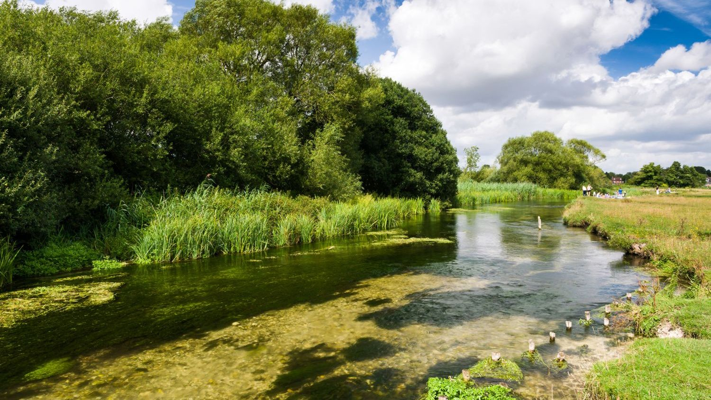
In search of our Chalk Stream Poet Laureate…

Slide 2
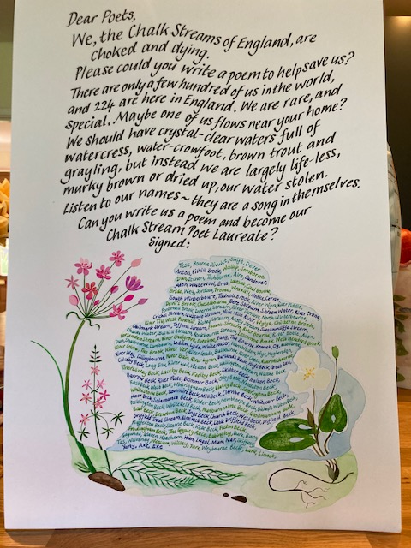
A plea for help:

Slide 3
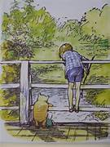
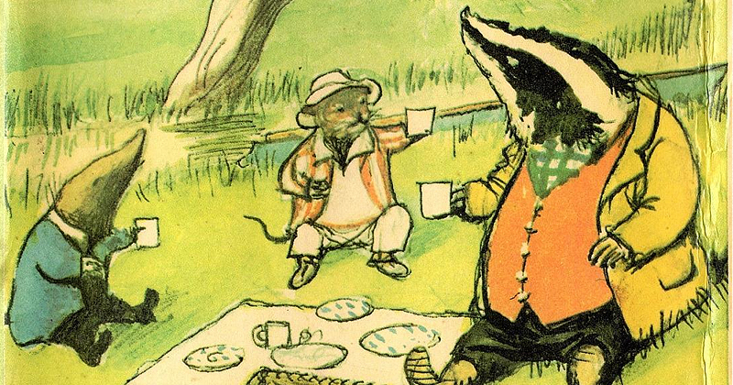
Chalk Streams in stories:
Winnie the Pooh likely threw his pooh sticks into a chalk stream
Wind in the Willows describes a quintessential chalk stream as the setting for Mole, Ratty and Toad’s adventures: one theory is that they were inspired by the sighting of a water vole on the River Pang.
Rupert Brooke’s poem Grantchester describes ‘a bosky wood, a slumbrous stream’….

Slide 4
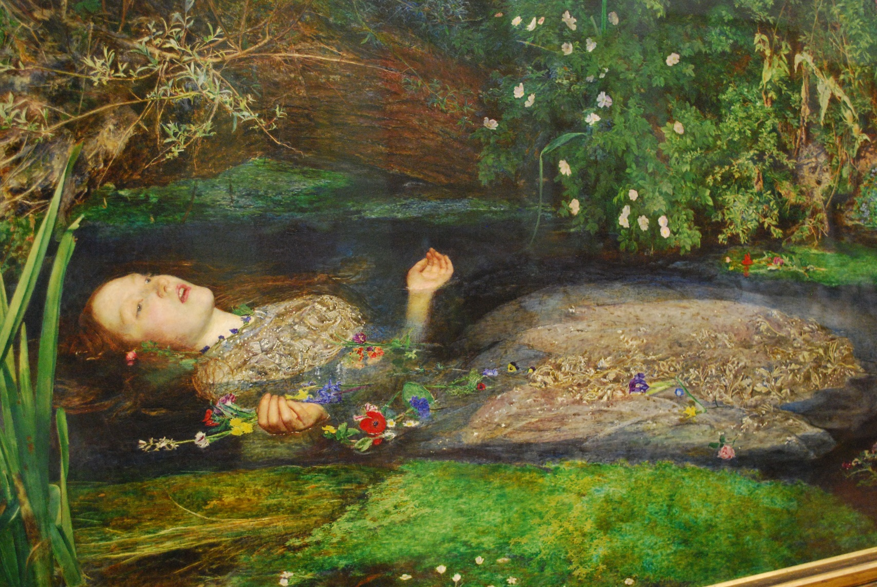
Chalk streams in art: Ophelia
The much-loved pre-Raphaelite painting Ophelia was painted by Millais at the Hogsmill chalk stream in Surrey. He painted the stream on location, and then his 19-year old model in a bath tub of cold water in his studio. She caught pneumonia and nearly died! Today the Hogsmill is brown and murky, and in a sorry state.

Slide 5
What would YOU like to do by a clear, clean, beautiful stream?
Swim?
Canoe?
Paddle?
Skim stones?
Sketch flowers and insects?
Have a picnic?
Build a dam?
Read a book?
Do nothing?

Slide 6
Immerse yourself in the life of a chalk stream:
https://tinyurl.com/3xc35rn2

Slide 7
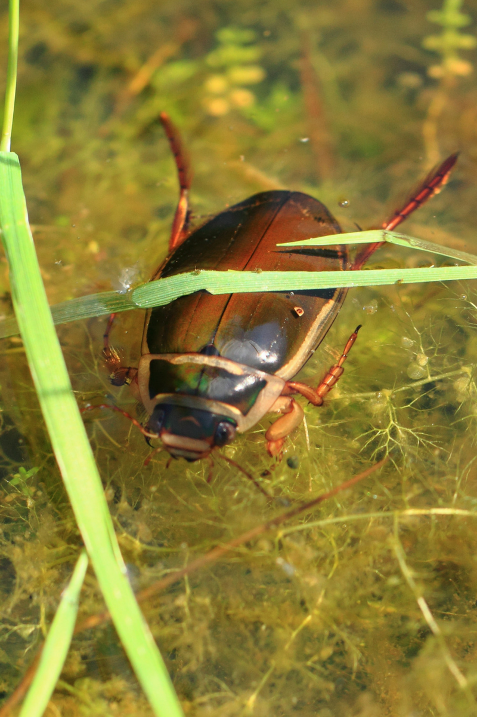
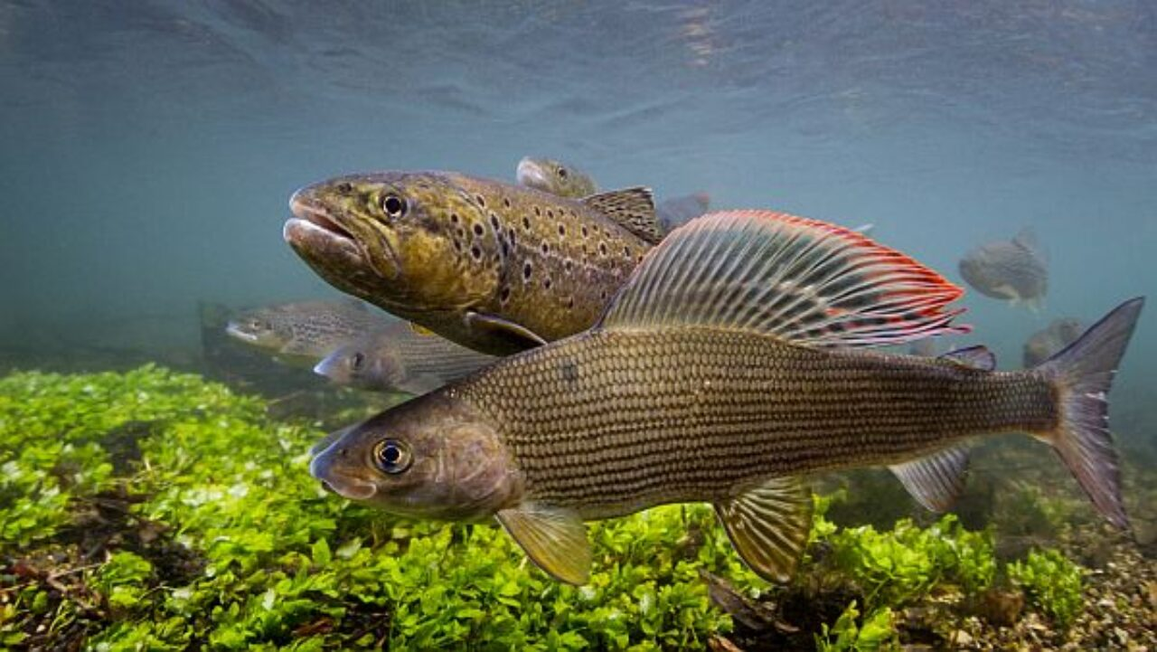
How to enter:
Send your poems to: chalkstreampoet@gmail.com
You can submit as many poems as you like.
Make sure you include your name and which
category you are entering:
Under 18 (include your age if you’d like to!) or
Over 18
Closing date 25th May 2024
Medals to be won!

